Slide 1



VI SEMESTER
BIG DATA TECHNOLOGIES
Phase-1
on
GraphPulse:
Scalable Analytics for Transaction Networks

Slide 2
Team Members
Alroy Deon Saldanha | Aniket RT | Amogh AP
1RV23AI012 | 1RV23AI017 | 1RV23AI013

Slide 3
Problem Statement
Modern financial transaction systems generate millions of interconnected records daily, forming complex graph structures that conventional tools cannot process efficiently.
Relational databases (SQL) fail at scale — complex joins cause performance bottlenecks
Single-machine systems cannot handle graph datasets with millions of nodes and edges
Traditional fraud detection is transaction-centric, missing sophisticated fraud rings that span multiple accounts
Extracting meaningful patterns (clusters, key nodes, ring structures) from raw graph data remains computationally expensive
Real-time fraud monitoring is near-impossible without distributed, low-latency pipelines

Slide 4
Objectives
Build a distributed data pipeline: Ingest, partition, and process large-scale graph datasets using Apache Spark.
Enable parallel data processing: Execute distributed transformations across multiple nodes to reduce processing time.
Perform graph analytics: Compute metrics such as node degree, connected components, and PageRank to identify key nodes and relationships.
Optimize storage and visualize insights: Store data in Parquet format for efficient querying and present patterns, clusters, and node importance through visualization tools.

Slide 5
Literature Survey
# | Paper | Year | Concept Defined | Research Gap
1 | Liu et al. — Big Data-Driven Fraud Detection Using Machine Learning and Real-Time Stream Processing (arXiv) | 2025 | Scalable fraud detection framework using Apache Spark, Kafka/Flink for streaming, and AWS S3 for distributed storage; trains classification models on engineered features | Limited focus on graph-based relational fraud patterns and fraud ring detection; lacks explainable AI integration for investigator-level interpretation
2 | RL-GNN — Reinforcement Learning with GNN Fusion for Real-Time Financial Fraud Detection (Scientific Reports) | 2025 | Integrates Graph Attention Networks with an RL controller and community-swapping data mining for fraud detection on IEEE-CIS data; achieves AUROC 0.872 | High computational complexity due to RL + GAT integration; scalability challenges for large distributed transaction graphs
3 | Jain et al. — Explainable AI in Big Data Fraud Detection (arXiv) | 2025 | Reviews XAI methods (LIME, SHAP, counterfactual explanations, attention mechanisms) integrated into Big Data fraud pipelines; identifies gaps in real-time and graph-model explainability | Primarily theoretical review; lacks implementation of scalable real-time explainability integrated with graph neural networks
4 | Motie & Raahemi — Financial Fraud Detection Using Graph Neural Networks: A Systematic Review (Expert Systems with Applications) | 2024 | Comprehensive taxonomy of GNN architectures applied to financial fraud; shows GNNs outperform traditional methods by capturing relational patterns in transaction networks | Survey-oriented work without deployment architecture or distributed implementation strategy for real-time fraud detection
5 | Onur Erboy et al. — Weighted XGBoost Based Active Learning Framework for Fraud Detection (Springer, CD-MAKE 2024) | 2024 | Proposes an active learning framework for imbalanced fraud datasets using a small number of labelled samples; human-in-the-loop querying improves model iteratively | Relies on traditional ML (XGBoost) instead of graph-based learning; limited capability to capture interconnected fraud behavior

Slide 6
Literature Survey
# | Paper | Year | Concept Defined | Research Gap
6 | ASA-GNN — Transaction Fraud Detection via an Adaptive Graph Neural Network (IEEE Transactions on Big Data) | 2023 | Proposes adaptive neighbor sampling and aggregation on transaction graphs; addresses noisy neighbors and class imbalance in GraphSAGE-style models | Increased model complexity and training overhead; limited discussion on distributed deployment and streaming integration
7 | Tong & Shen — Financial Transaction Fraud Detector Based on Imbalance Learning and GNN (Applied Soft Computing) | 2023 | Combines graph neural networks with oversampling for class-imbalanced fraud datasets; uses node embeddings for classification | Focuses mainly on imbalance handling; lacks real-time processing and explainability mechanisms
8 | Srivastava & Singh — Fraud Detection in the Distributed Graph Database (Cluster Computing) | 2023 | Proposes a node-rank based fraud detection algorithm using distributed graph data profiling; minimizes query bottlenecks on large graph datasets | Uses graph profiling techniques but lacks deep learning-based relational representation learning
9 | Adegbola — Graph-Augmented RNN Models for Detecting Coordinated Fraud Rings in Transaction Networks (SSRN) | 2023 | Combines RNN sequence modeling with GNN structural analysis to detect coordinated fraud rings; models inter-account relationships and temporal transaction sequences | Heavy sequential modeling increases computational cost; less suitable for scalable static graph analysis in distributed environments
10 | Lin — Large-Scale Network Embedding in Apache Spark (KDD 2021) | 2021 | Presents a distributed algorithm for graph/network embedding using Apache Spark; recursively partitions large graphs into subgraphs for parallel embedding computation | Focuses on scalable graph embedding but does not address fraud-specific classification, explainability, or active learning integration

Slide 7
Literature Survey
Summary of Literature Survey
Recent fraud detection research increasingly shifts from traditional ML to Graph Neural Networks (GNNs) for capturing relational transaction patterns.
GraphSAGE, GAT, and adaptive GNN architectures show improved fraud detection accuracy on interconnected financial networks.
Most existing works focus on either scalability, imbalance handling, explainability, or graph learning, but rarely integrate all together in a unified system.
Distributed Big Data frameworks such as Apache Spark and HDFS are widely adopted for handling large-scale transaction processing.
Explainable AI methods like SHAP and LIME are becoming essential for investigator trust and model transparency.
Active learning and human-in-the-loop systems improve fraud detection performance by incorporating investigator feedback.
Existing systems face limitations in real-time scalability, integrated explainability, distributed deployment, and fraud ring detection simultaneously.
Our proposed system combines distributed Big Data processing, GraphSAGE-based fraud detection, explainable AI, active learning, and community detection into a single scalable architecture.

Slide 8
Proposed Methodology
Data Ingestion and Partitioning: Large transaction datasets are loaded into Apache Spark and partitioned for parallel processing across distributed nodes.
Distributed Storage: Data is stored in distributed systems such as HDFS to enable scalable and fault-tolerant access.
Data Processing and Transformation: Spark performs filtering, joins, and aggregations on node and edge data in a distributed manner.
Graph-Based Analysis: GraphFrames or GraphX are used to compute metrics like node degree, connected components, and PageRank to identify key relationships.
Data Optimization and Visualization: Processed data is stored in Parquet format for efficient querying and visualized to highlight patterns and node importance.

Slide 9
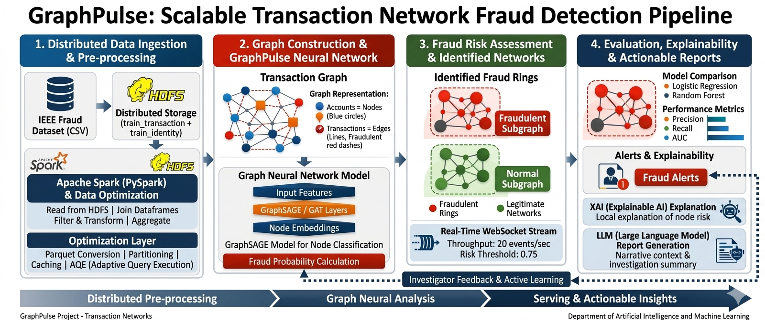
Architechture

Slide 10
Tools and Technologies
1. Data Infrastructure
Apache Hadoop HDFS — Distributed, fault-tolerant storage for large-scale transaction graphs
Apache Spark + PySpark — Parallel ETL, joins, filtering, and partitioning at scale
Parquet — Columnar storage for fast querying and reduced storage footprint
2. Graph Analytics & Modeling
GraphFrames / GraphX — Graph operations (PageRank, connected components, node degree)
GraphSAGE (PyTorch Geometric) — GNN-based node classification for fraud detection
3. Machine Learning Stack
Python — Core pipeline orchestration
Pandas — Local data preprocessing
scikit-learn — Baseline models (Logistic Regression, Random Forest) + evaluation
4. System & Integration Layer
WebSocket — Real-time transaction streaming (~20 events/sec)
REST API + JWT — Secure backend integration for case management
5. Intelligence & Data Source
LLM (Large Language Model) — Automated fraud investigation reports
Kaggle IEEE-CIS Dataset — Real-world financial transaction data

Slide 11
Thank You

